Slide 1
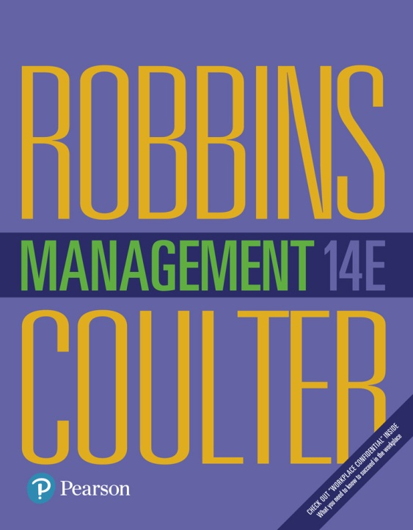
Management
Fourteenth Edition
Chapter 18
Monitoring and Controlling
Copyright © 2018, 2016, 2014 Pearson Education, Inc. All Rights Reserved

Slide 2
Learning Objectives
18.1 Explain the nature and importance of control.
18.2 Describe the three steps in the control process.
18.3 Explain how organizational and employee performance are measured.
Know how to be effective at giving feedback.
18.4 Describe tools used to measure organizational performance.
18.5 Discuss contemporary issues in control.
Develop your skill at dealing with difficult people.

Slide 3
What Is Controlling and Why Is It Important?
Controlling: management function that involves monitoring, comparing, and correcting work performance
Notes:
What is controlling? It’s the process of monitoring, comparing, and correcting work performance. All managers should control even if their units are performing as planned because they can’t really know that unless they’ve evaluated what activities have been done and compared actual performance against the desired standard.
Effective controls ensure that activities are completed in ways that lead to the attainment of goals. Whether controls are effective, then, is determined by how well they help employees and managers achieve their goals.

Slide 4
Why Is Control So Important?
Planning
Empowering employees
Protecting the workplace
Notes:
Why is control so important? Planning can be done, an organizational structure created to facilitate efficient achievement of goals, and employees motivated through effective leadership. But there’s no assurance that activities are going as planned and that the goals employees and managers are working toward are, in fact, being attained.
Control is important, therefore, because it’s the only way that managers know whether organizational goals are being met and if not, the reasons why. The value of the control function can be seen in three specific areas: planning, empowering employees, and protecting the workplace.
Many managers are reluctant to empower their employees because they fear something will go wrong for which they would be held responsible. But an effective control system can provide information and feedback on employee performance and minimize the chance of potential problems.
The final reason why managers control is to protect the organization and its assets. Today’s environment brings heightened threats from natural disasters, financial scandals, workplace violence, global supply chain disruptions, security breaches, and even possible terrorist attacks. Managers must protect organizational assets in the event that any of these things should happen.

Slide 5
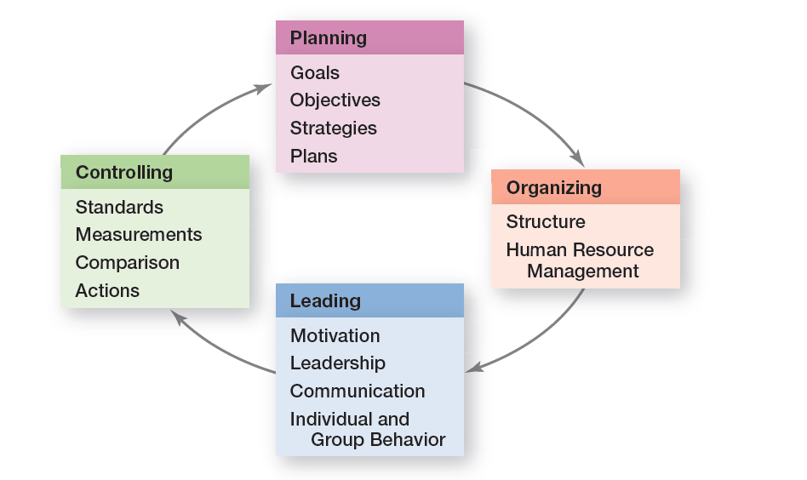
Exhibit 18-1 Planning-Controlling Link
Exhibit 18-1 shows shows how controlling provides a critical link back to planning.
Notes:
Controlling provides a critical link back to planning (see Exhibit 18-1). If managers didn’t control, they’d have no way of knowing whether their goals and plans were being achieved and what future actions to take.

Slide 6
The Control Process
Control process: a three-step process of measuring actual performance, comparing actual performance against a standard, and taking managerial action to correct deviations or inadequate standards
Notes:
The control process is a three-step process of measuring actual performance, comparing actual performance against a standard, and taking managerial action to correct deviations or to address inadequate standards. The control process assumes that performance standards already exist, and they do. They’re the specific goals created during the planning process.

Slide 7
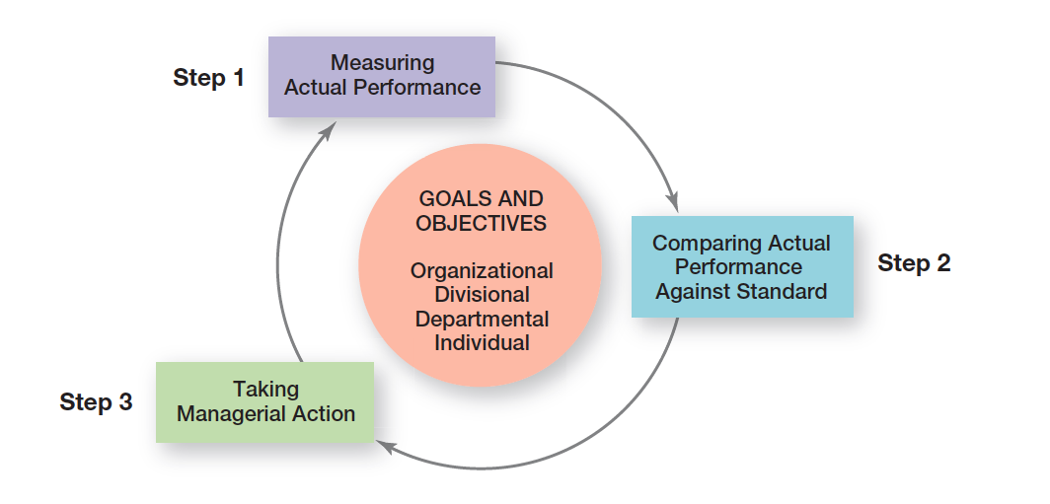
Exhibit 18-2 The Control Process
Exhibit 18-2 illustrates the three-step control process.

Slide 8
Step 1: Measuring Actual Performance
How we measure
What we measure
Notes:
Four approaches used by managers to measure and report actual performance are personal observations, statistical reports, oral reports, and written reports. Exhibit 18-3 summarizes the advantages and drawbacks of each approach. Most managers use a combination of these approaches.
To determine what actual performance is, a manager must first get information about it. Thus, the first step in control is measuring.
What is measured is probably more critical to the control process than how it’s measured. Why? Because selecting the wrong criteria can create serious problems. Besides, what is measured often determines what employees will do.
Most work activities can be expressed in quantifiable terms. However, managers should use subjective measures when they can’t. Although such measures may have limitations, they’re better than having no standards at all and doing no controlling.

Slide 9
Exhibit 18-3: Sources of Information for Measuring Performance
Method | Benefits | Drawbacks
Personal Observations | -Get firsthand knowledge -Information isn’t filtered -Intensive coverage of work activities | -Subject to personal biases -Time-consuming -Obtrusive
Statistical Reports | -Easy to visualize -Effective for showing relationships | -Provide limited information -Ignore subjective factors
Oral Reports | -Fast way to get information -Allow for verbal and nonverbal feedback | -Information is filtered -Information can’t be documented
Written Reports | -Comprehensive -Formal -Easy to file and retrieve | -Take more time to prepare
Notes:
Four approaches used by managers to measure and report actual performance are personal observations, statistical reports, oral reports, and written reports. Exhibit 18-3 summarizes the advantages and drawbacks of each approach. Most managers use a combination of these approaches.

Slide 10
Step 2: Comparing Actual Performance Against the Standard
Range of variation: the acceptable parameters of variance between actual performance and the standard
Notes:
The comparing step determines the variation between actual performance and the standard. Although some variation in performance can be expected in all activities, it’s critical to determine an acceptable range of variation.

Slide 11
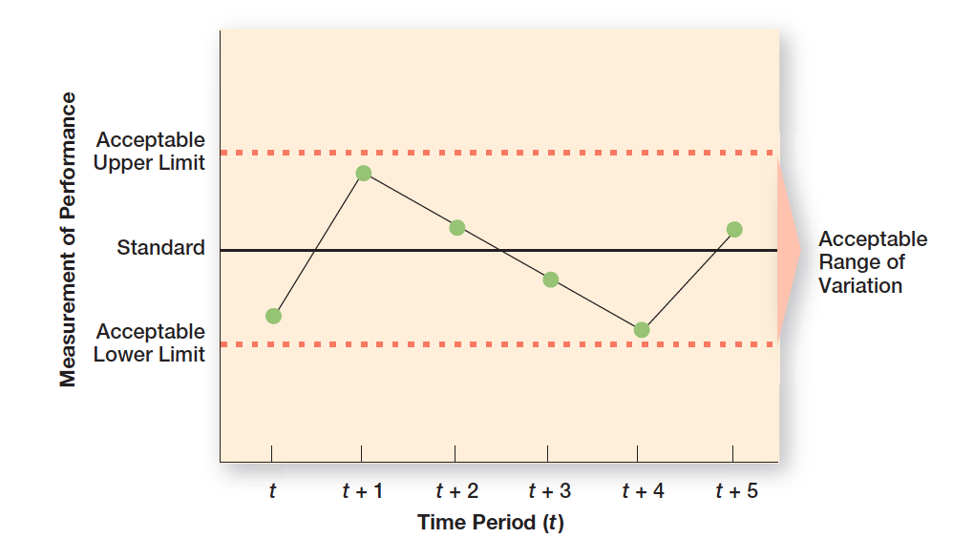
Exhibit 18-4 Acceptable Range of Variation
Exhibit 18-4 illustrates the acceptable range of variation.

Slide 12
Exhibit 18-5 Green Earth Gardening Supply—July Sales
Product | Standard | Actual | Over (Under)
Vegetable plants | 1,075 | 913 | (162)
Perennial flowers | 630 | 634 | 4
Annual flowers | 800 | 912 | 112
Herbs | 160 | 140 | (20)
Flowering bulbs | 170 | 286 | 116
Flowering bushes | 225 | 220 | (5)
Heirloom seeds | 540 | 672 | 132
Total | 3,600 | 3,777 | 177

Slide 13
Step 3: Taking Managerial Action
Correct actual performance
Immediate corrective action: corrective action that corrects problems at once to get performance back on track
Basic corrective action: corrective action that looks at how and why performance deviated before correcting the source of deviation
Notes:
Managers can choose among three possible courses of action: do nothing, correct the actual performance, or revise the standards. Because “do nothing” is self-explanatory, let’s look at the other two.
One decision a manager must make is whether to take immediate corrective action, which corrects problems at once to get performance back on track, or to use basic corrective action, which looks at how and why performance deviated before correcting the source of deviation.

Slide 14
Revise the Standard
If performance consistently exceeds the goal, then a manager should look at whether the goal is too easy and needs to be raised.
Managers must be cautious about revising a standard downward.
Notes:
It’s possible that the variance was a result of an unrealistic standard—too low or too high a goal. In that situation, the standard needs the corrective action, not the performance. If performance consistently exceeds the goal, then a manager should look at whether the goal is too easy and needs to be raised. On the other hand, managers must be cautious about revising a standard downward.

Slide 15
Managerial Decisions in Controlling
Depending on the results, a manager’s decision is to do nothing, correct the performance, or revise the standard.
Notes:
The standards are goals developed during the planning process. These goals provide the basis for the control process, which involves measuring actual performance and comparing it against the standard. Depending on the results, a manager’s decision is to do nothing, correct the performance, or revise the standard.

Slide 16
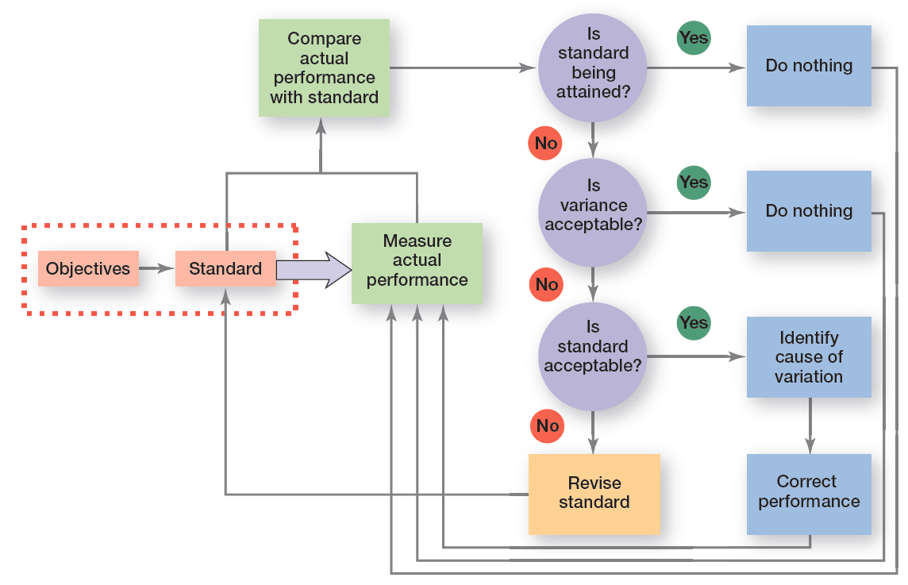
Exhibit 18-6 Managerial Decisions in the Control Process
Exhibit 18-6 summarizes the decisions a manager makes in controlling

Slide 17
What is Organizational Performance?
Performance: the end result of an activity
Organizational performance: the accumulated results of all the organization’s work activities
Notes:
Performance is the end result of an activity. And whether that activity is hours of intense practice before a concert or race or whether it’s carrying out job responsibilities as efficiently and effectively as possible, performance is what results from that activity.
Managers are concerned with organizational performance—the accumulated results of all the organization’s work activities. It’s a multifaceted concept, but managers need to understand the factors that contribute to organizational performance.

Slide 18
Measures of Organizational Performance
Productivity: the amount of goods or services produced divided by the inputs needed to generate that output
Organizational effectiveness: a measure of how appropriate organizational goals are and how well those goals are being met
Notes:
Productivity is the amount of goods or services produced divided by the inputs needed to generate that output. Organizations and individual work units want to be productive. They want to produce the most goods and services using the least amount of inputs. Output is measured by the sales revenue an organization receives when goods are sold (selling price × number sold). Input is measured by the costs of acquiring and transforming resources into outputs.
Organizational effectiveness is a measure of how appropriate organizational goals are and how well those goals are met. That’s the bottom line for managers, and it’s what guides managerial decisions in designing strategies and work activities and in coordinating the work of employees.

Slide 19
Exhibit 18-7: Popular Industry and Company Rankings
Fortune (www.fortune.com) | IndustryWeek (www.industryweek.com) | Forbes (www.forbes.com) | Customer Satisfaction Indexes
Fortune 500 | IndustryWeek 1,000 | World’s Biggest Public Companies | American Customer Satisfaction Index— University of Michigan Business School
Global 500 | IndustryWeek U.S. 500 | blank | Customer Satisfaction Measurement Association
World’s Most Admired Companies | 50 Best Manufacturers | blank | blank
100 Best Companies to Work For | IndustryWeek Best Plants | blank | blank
100 Fastest-Growing Companies | blank | blank | blank
Notes:
Rankings are a popular way for managers to measure their organization’s performance. And there’s not a shortage of these rankings as Exhibit 18-7 shows. Rankings are determined by specific performance measures, which are different for each list.

Slide 20
Controlling for Employee Performance
Disciplinary action: actions taken by a manager to enforce the organization’s work standards and regulations
Progressive disciplinary action: an approach to ensure that the minimum penalty appropriate to the offense is imposed
Notes:
It’s particularly important for managers to deliver effective performance feedback and to be prepared, if needed, to use disciplinary actions—actions taken by a manager to enforce the organization’s work standards and regulation.
We like to know how we’re doing. Managers need to provide their employees with feedback so that the employees know where they stand in terms of their work. When giving performance feedback, both parties need to feel heard, understood, and respected. And if done that way, positive outcomes can result.
Progressive disciplinary action is intended to ensure that the minimum penalty appropriate to the offense is imposed.

Slide 21
Exhibit 18-8: Types of Discipline Problems and Examples of Each
Problem Type | Examples of Each
Attendance | Absenteeism, tardiness, abuse of sick leave
On-the-Job Behaviors | Insubordination, failure to use safety devices, alcohol or drug abuse
Dishonesty | Theft, lying to supervisors, falsifying information on employment application or on other organizational forms
Outside Activities | Criminal activities, unauthorized strike activities, working for a competing organization (if no-compete clause is part of employment)
Notes:
Exhibit 18-8 lists some common types of work discipline problems and examples of each. In those circumstances, it’s important for a manager to know what the organization’s policies are on discipline. Is there a process for dealing with unsatisfactory job performance? Do warnings need to be given when performance is inadequate? What happens if after the warnings, performance or the troublesome behavior doesn’t improve? Disciplinary actions are never easy or pleasant; however, discipline can be used to both control and correct employee performance, and managers must know how to discipline.

Slide 22
Feedforward/Concurrent/Feedback Controls
Feedforward control: control that takes place before a work activity is done
Concurrent control: control that takes place while a work activity is in progress
Management by walking around: a term used to describe when a manager is out in the work area interacting directly with employees
Feedback control: control that takes place after a work activity is done
Notes:
The most desirable type of control—feedforward control—prevents problems because it takes place before the actual activity. The key to feedforward controls is taking managerial action before a problem occurs. That way, problems can be prevented rather than having to correct them after any damage (poor-quality products, lost customers, lost revenue, etc.) has already been done.
Concurrent control, as its name implies, takes place while a work activity is in progress.
The best-known form of concurrent control is direct supervision. Another term for it is management by walking around, which is when a manager is in the work area interacting directly with employees.
The most popular type of control relies on feedback. In feedback control, the control takes place after the activity is done. Feedback controls have two advantages. First, feedback gives managers meaningful information on how effective their planning efforts were. Feedback that shows little variance between standard and actual performance indicates that the planning was generally on target. Second, feedback can enhance motivation. People want to know how well they’re doing and feedback provides that information.

Slide 23
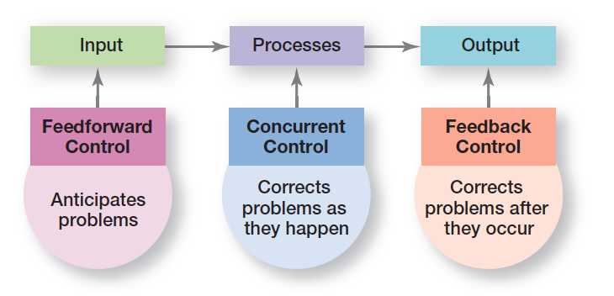
Exhibit 18-9 Types of Control
Exhibit 18-9 shows the three kinds of control
Notes:
Managers can implement controls before an activity begins, during the time the activity is going on, and after the activity has been completed. The first type is called feedforward control; the second, concurrent control; and the last, feedback control (see Exhibit 18-9).

Slide 24
Financial Controls
Traditional controls
Ratio analysis:
Liquidity
Leverage
Activity
Profitability
Budget analysis:
Quantitative standards
Deviations
Notes:
Every business wants to earn a profit. To achieve this goal, managers need financial controls. For instance, they might analyze quarterly income statements for excessive expenses. They might also calculate financial ratios to ensure that sufficient cash is available to pay ongoing expenses, that debt levels haven’t become too high, or that assets are used productively.
Budgets are planning and control tools. When a budget is formulated, it’s a planning tool because it indicates which work activities are important and what and how much resources should be allocated to those activities. But budgets are also used for controlling because they provide managers with quantitative standards against which to measure and compare resource consumption. If deviations are significant enough to require action, the manager examines what has happened and tries to uncover why.

Slide 25
Exhibit 18-10: Popular Financial Ratios
Objective | Ratio | Calculation | Meaning
Liquidity | Current ratio | Current assets Current liabilities | Tests the organization’s ability to meet short-term obligations
Liquidity | Acid test | Current assets less inventories Current liabilities | Tests liquidity more accurately when inventories turn over slowly or are difficult to sell
Leverage | Debt to assets | Total debt Total assets | The higher the ratio, the more leveraged the organization
Leverage | Times interest earned | Profits before interest/taxes Total interest charges | Measures how many times the organization is able to meet its interest expenses
Activity | Inventory turnover | Sales Inventory | The higher the ratio, the more efficiently inventory assets are used
Activity | Total asset turnover | Sales Total Assets | The fewer assets used to achieve a given level of sales, the more efficiently management uses the organization’s total assets
Profitability | Profit margin on sales | Net profit after taxes Total sales | Identifies the profits that are generated
Profitability | Return on investment | Net profit after taxes Total assets | Measures the efficiency of assets to generate profits
Notes:
Managers might use traditional financial measures such as ratio analysis and budget analysis. Exhibit 18-10 summarizes some of the most popular financial ratios. Liquidity ratios measure an organization’s ability to meet its current debt obligations. Leverage ratios examine the organization’s use of debt to finance its assets and whether it’s able to meet the interest payments on the debt. Activity ratios assess how efficiently a company uses its assets. Finally, profitability ratios measure how efficiently and effectively the company uses its assets to generate profits. These ratios are calculated using selected information from the organization’s two primary financial statements (the balance sheet and the income statement), which are then expressed as a percentage or ratio.

Slide 26
Information Controls
Management information system (MIS): a system used to provide management with needed information on a regular basis
Data versus information
Notes:
In measuring actual performance, managers need information about what is happening within their area of responsibility and about the standards in order to be able to compare actual performance with the standard.
A management information system (MIS) is a system used to provide managers with needed information on a regular basis. In theory, this system can be manual or computer-based, although most organizations have moved to computer-supported applications. The term system in MIS implies order, arrangement, and purpose. Further, an MIS focuses specifically on providing managers with information (processed and analyzed data), not merely data (raw, unanalyzed facts).

Slide 27
Balanced Scorecard
Balanced scorecard: a performance measurement tool that looks at more than just the financial perspective
Notes:
The balanced scorecard approach is a way to evaluate organizational performance from more than just the financial perspective.
A balanced scorecard typically looks at four areas that contribute to a company’s performance: financial, customer, internal processes, and people/innovation/growth assets. According to this approach, managers should develop goals in each of the four areas and then measure whether the goals are being met.

Slide 28
Benchmarking of Best Practices
Benchmarking: a performance measurement tool that looks at more than just the nancial perspective
Benchmark: the standard of excellence against which to measure and compare
Notes:
Benchmarking is the search for the best practices among competitors or noncompetitors that lead to their superior performance. Benchmarking should identify various benchmarks, the standards of excellence against which to measure and compare.

Slide 29
Exhibit 18-11: Suggestions for Internal Bookmarking
Suggestions
1. Connect best practices to strategies and goals. The organization’s strategies and goals should dictate what types of best practices might be most valuable to others in the organization.
2. Identify best practices throughout the organization. Organizations must have a way to find out what practices have been successful in different work areas and units.
3. Develop best practices reward and recognition systems. Individuals must be given an incentive to share their knowledge. The reward system should be built into the organization’s culture.
4. Communicate best practices throughout the organization. Once best practices have been identified, that information needs to be shared with others in the organization.
5. Create a best practices knowledge-sharing system. There needs to be a formal mechanism for organizational members to continue sharing their ideas and best practices.
6. Nurture best practices on an ongoing basis. Create an organizational culture that reinforces a “we can learn from everyone” attitude and emphasizes sharing information.
Notes:
Sometimes those best practices can be found inside the organization and just need to be shared. Exhibit 18-11 provides some suggestions for internal benchmarking.
Source: Based on “Extracting Diamonds in the Rough,” by Tad Leahy, from Business Finance, August 2000.

Slide 30
Adjusting Controls for Cross-Cultural Differences and Global Turmoil
Distance creates formalized controls, e.g. formal reports
Impact of technology
Constraints due to local laws
Comparability issues in data collection
Be prepared for global turmoil and disasters
Notes:
In a global corporation, managers of foreign operations tend to be less controlled by the home office, if for no other reason than the distance keeping managers from being able to observe work directly. Because distance creates a tendency to formalize controls, such organizations often rely on extensive formal reports for control, most of which are communicated electronically.
Managers in countries where technology is more advanced often use indirect control devices such as computer-generated reports and analyses in addition to standardized rules and direct supervision to ensure that work activities are going as planned. In less technologically advanced countries, however, managers tend to use more direct supervision and highly centralized decision making for control.
Some countries’ laws prohibit closing facilities, laying off employees, taking money out of the country, or bringing in a new management team from outside the country.
Another challenge for global managers in collecting data for measurement and comparison is comparability. This difference makes it hard to compare, for instance, labor costs per unit.
The best time to be prepared is before an emergency occurs, and many organizations are doing just that, so that if a crisis o

Slide 31
Workplace Privacy
Employers can read your e-mail, tap your telephone, monitor your work by computer, store and review computer files.
Reasons companies monitor:
Productivity/Internet traffic
Concerns about offensive/inappropriate material
Protecting company secrets
Notes:
If you work, do you think you have a right to privacy at your job? What can your employer find out about you and your work? You might be surprised at the answers! Employers can (and do), among other things, read your e-mail (even those marked “personal or confidential”), tap your telephone, monitor your work by computer, store and review computer files, monitor you in an employee bathroom or dressing room, and track your whereabouts in a company vehicle.
And these actions aren’t that uncommon. In fact, some 26 percent of companies have fired an employee for e-mail misuse; 26 percent have fired workers for misusing the Internet; 6 percent have fired employees for inappropriate cell phone use; 4 percent have fired someone for instant messaging misuse; and 3 percent have fired someone for inappropriate text messaging.

Slide 32
Employee Theft
Employee theft: any unauthorized taking of company property by employees for their personal use
Notes:
Employee theft is defined as any unauthorized taking of company property by employees for their personal use. It can range from embezzlement to fraudulent filing of expense reports to removing equipment, parts, software, or office supplies from company premises. Managers need to educate themselves about this control issue and be prepared to deal with it.
Thankfully the number of workplace shootings has decreased. However, the U.S. National Institute of Occupational Safety and Health still says that each year, some 2 million American workers are victims of some form of workplace violence. In an average week, one employee is killed and at least 25 are seriously injured in violent assaults by current or former coworkers.

Slide 33
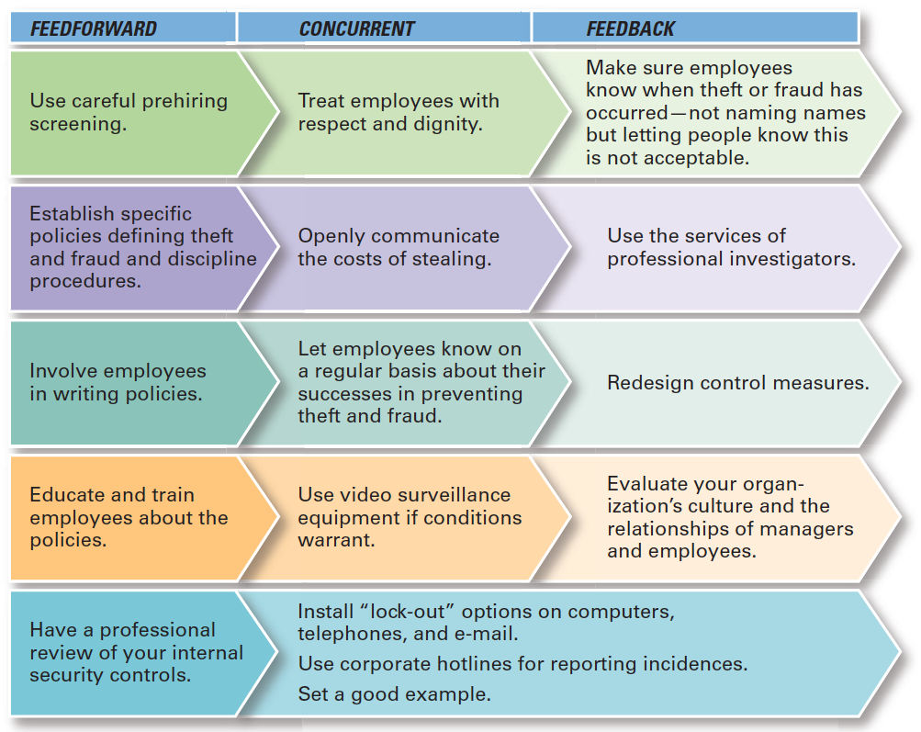
Exhibit 18-12 Controlling Employee Theft
Exhibit 18-12 summarizes several possible managerial actions to control employee theft.
Notes:
Sources: Based on A. H. Bell and D. M. Smith, “Protecting the Company Against Theft and Fraud,” Workforce Management Online, December 3, 2000; J. D. Hansen, “To Catch a Thief,” Journal of Accountancy, March 2000, pp. 43–46; and J. Greenberg, “The Cognitive Geometry of Employee Theft,” in Dysfunctional Behavior in Organizations: Nonviolent and Deviant Behavior, ed. S. B. Bacharach, A. O’Leary-Kelly, J. M. Collins, and R. W. Griffin (Stamford, CT: JAI Press, 1998), pp. 147–193.

Slide 34
Workplace Violence
The U.S. National Institute of Occupational Safety and Health still says that each year, some 2 million American workers are victims of some form of workplace violence.
Notes:
What factors are believed to contribute to workplace violence? Undoubtedly, employee stress caused by an uncertain economic environment, job uncertainties, declining value of retirement accounts, long hours, information overload, other daily interruptions, unrealistic deadlines, and uncaring managers play a role. Even office layout designs with small cubicles where employees work amid the noise and commotion from those around them have been cited as contributing to the problem.
What can managers do to deter or reduce possible workplace violence? Once again, the concept of feedforward, concurrent, and feedback control can help identify actions that managers can take. Exhibit 18-13 summarizes several suggestions. The noise and commotion from those around them have been cited as contributing to the problem.

Slide 35
Exhibit 18-13: Controlling Workplace Violence
Feedforward | Concurrent | Feedback
Use MBWA (managing by walking around) to identify potential problems; observe how employees treat and interact with each other. |  | Communicate openly about incidences and what’s being done.
Provide employee assistance programs (EAPs) to help employees with behavioral problems. | Allow employees or work groups to “grieve” during periods of major organizational change. | Investigate incidents and take appropriate action.
Enforce organizational policy that any workplace rage, aggression, or violence will not be tolerated. | Be a good role model in how you treat others. | Review company policies and change, if necessary.
Use careful prehiring screening. | Use corporate hotlines or some other mechanism for reporting and investigating incidents.
Never ignore threats. | Use quick and decisive intervention.
Train employees about how to avoid danger if situation arises. | Get expert professional assistance if violence erupts.
Clearly communicate policies to employees. | Provide necessary equipment or procedures for dealing with violent situations (cell phones, alarm system, code names or phrases, and so forth).
Notes:
Sources: Based on M. Gorkin, “Five Strategies and Structures for Reducing Workplace Violence,” Workforce Management Online, December 3, 2000; “Investigating Workplace Violence: Where Do You Start? Workforce Management Online, December 3, 2000; “Ten Tips on Recognizing and Minimizing Violence,” Workforce Management Online, December 3, 2000; and “Points to Cover in a Workplace Violence Policy,” Workforce Management Online, December 3, 2000.

Slide 36
Controlling Customer Interactions
Service profit chain: the service sequence from employees to customers to profit
Notes:
How can managers control the interactions between the goal and the outcome when it comes to customers? The concept of a service profit chain can help.
A service profit chain is the service sequence from employees to customers to profit. According to this concept, the company’s strategy and service delivery system influence how employees deal with customers; that is, how productive they are in providing service and the quality of that service.

Slide 37
Corporate Governance
Corporate governance: the system used to govern a corporation so that the interests of corporate owners are protected
Notes:
Corporate governance, the system used to govern a corporation so that the interests of corporate owners are protected. It failed abysmally at Enron, as it has at many companies caught in financial scandals. In the aftermath of these scandals, corporate governance has been reformed.
The original purpose of a board of directors was to have a group, independent from management, looking out for the interests of shareholders who were not involved in the day-to-day management of the organization. However, it didn’t always work that way. Board members often enjoyed a cozy relationship with managers in which each took care of the other. The Sarbanes-Oxley Act puts greater demands on board members of publicly traded companies in the United States to do what they were empowered and expected to do.

Slide 38
Review Learning Objective 18.1
Explain the nature and importance of control.
Controlling = monitoring, comparing, correcting
Important:
Are goals being met?
Provides information/feedback
Protects organization and assets
Notes:
Controlling is the process of monitoring, comparing, and correcting work performance. As the final step in the management process, controlling provides the link back to planning. If managers didn’t control, they’d have no way of knowing whether goals were being met. Control is important because (1) it’s the only way to know if goals are being met, and if not, why; (2) it provides information and feedback so managers feel comfortable empowering employees; and (3) it helps protect an organization and its assets.

Slide 39
Review Learning Objective 18.2
Describe the three steps in the control process.
Measuring
Comparing
Taking action
Notes:
The three steps in the control process are measuring, comparing, and taking action.
Measuring involves deciding how to measure actual performance and what to measure.
Comparing involves looking at the variation between actual performance and the standard (goal). Deviations outside an acceptable range of variation need attention. Taking action can involve doing nothing, correcting the actual performance, or revising the standards. Doing nothing is self-explanatory.
Correcting the actual performance can involve different corrective actions, which can either be immediate or basic. Standards can be revised by either raising or lowering them.

Slide 40
Review Learning Objective 18.3
Explain how organizational and employee performance are measured.
Productivity
Effectiveness
Industry and company rankings
Notes:
Organizational performance is the accumulated results of all the organization’s work activities. Three frequently used organizational performance measures include (1) productivity, the output of goods or services produced divided by the inputs needed to generate that output; (2) effectiveness, a measure of how appropriate organizational goals are and how well those goals are being met; and (3) industry and company rankings compiled by various business publications. Employee performance is controlled through effective performance feedback and through disciplinary actions, when needed.

Slide 41
Review Learning Objective 18.4
Describe tools used to measure organizational performance.
Feedforward controls
Concurrent controls
Feedback controls
Financial controls
Information controls
Balanced scorecards
Benchmarking
Notes:
Feedforward controls take place before a work activity is done. Concurrent controls take place while a work activity is being done. Feedback controls take place after a work activity is done.
Financial controls that managers can use include financial ratios (liquidity, leverage, activity, and profitability) and budgets. One information control managers can use is an MIS, which provides managers with needed information on a regular basis. Others include comprehensive and secure controls such as data encryption, system firewalls, data back-ups, and so forth that protect the organization’s information.
Balanced scorecards provide a way to evaluate an organization’s performance in four different areas rather than just from the financial perspective. Benchmarking provides control by finding the best practices among competitors or noncompetitors and from inside the organization itself.

Slide 42
Review Learning Objective 18.5
Discuss contemporary issues in control.
Cross-cultural differences
Workplace privacy
Employee theft
Workplace violence
Customer interactions
Corporate governance
Notes:
Adjusting controls for cross-cultural differences may be needed primarily in the areas of measuring and taking corrective actions.
Workplace concerns include cross-cultural differences, workplace privacy, employee theft, and workplace violence. For each of these issues, managers need to have policies in place to control inappropriate actions and ensure that work is getting done efficiently and effectively.
Control is important to customer interactions because employee service productivity and service quality influences customer perceptions of service value. Organizations want long-term and mutually beneficial relationships among their employees and customers.
Corporate governance is the system used to govern a corporation so that the interests of corporate owners are protected.

Slide 43
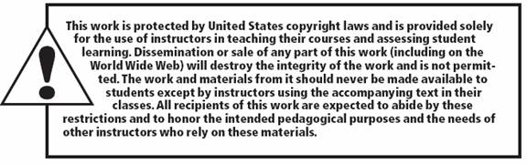
Copyright

